Slide 1

VISVESVARAYA TECHNOLOGICAL UNIVERSITY BELAGAVI
A Mini Project Report on
“GROCERY SHOP MANAGEMENT SYSTEM”
Submitted in the partial fulfillment for the requirements for the conferment of degree of
BACHELOR OF ENGINEERING
In
COMPUTER SCIENCE AND ENGINEERING
By
MS.ASTHA
Ms. KAUSHAKI PANDEY
DEPARTMENT OF COMPUTER SCIENCE
2021-2022
CERTIFICATE
This is to certify that the Mini Project work entitled “GROCERY SHOP MANAGEMENT SYSTEM” is a bonafide work carried out by Ms. ASTHA and Ms. Kaushaki pandey partial fulfillment for the award of Bachelor of Engineering Degree in Computer-Science and Engineering of the Visvesvaraya Technological University, Belagavi during the year 2021-2022. It is certified that all corrections/suggestions indicated for Internal Assessment have been incorporated

Slide 2
Grocery Shop Management System 2
in this report. The Mini project report has been approved as it satisfies the academic requirements in respect of project work for the B.E Degree.
Signature of the Guide | Signature of the guide | Signature of the HOD
Name of the Examiners 1. |  | Signature with Date
2.

Slide 3
Grocery Shop Management System
3
ABSTRACT
The main objectives of the project on Grocery Shop Management System to manage the details of Customer, Product, Product Company, Product Type, Supplier. It manages all the information about Customer, Stock, Supplier, Customer. The project is totally built at administrative end and thus only the administrator is guaranteed the access. The purpose of the project is to build an application program to reduce the manual work for managing the Customer, Product, Stock,Product Company. It tracks all the details about the Product Company,Product Type, Supplier.
The Grocery Shop Management System is to automate the existing manual system by the help of computerized equipments and full-fledged computer software, fulfilling their requirements, so that their valuable data/information can be stored for a longer period with easy accessing and manipulation of the same. The required software and hardware are easily available and easy to work with.
Grocery Shop Management System, as described above, can lead to error free, secure, reliable and fast management system. It can assist the user to concentrate on their other activities rather to concentrate on the record keeping. Thus it will help organization in better utilization of resources. The organization can maintain computerized records without redundant entries. That means that one need not be distracted by information that is not relevant, while being ablr to reach the information. Basically the project describes how to managefor good performance and better services for the clients.

Slide 4
Grocery Shop Management System
4
ACKNOWLEDGEMENT
I am happy to present this Mini project after completing it successfully. This project would not have been possible without the guidance, assistance and suggestions of many individuals. I would like to express my deep sense of gratitude and indebtedness to each and every one who has helped me to make this project a success.
I heartily thank our Principal, DR.MURALI,ACS COLLEGE OF ENGINEERING for his constant encouragement and inspiration in taking up this Mini project.
I heartily thank our Head of the Department, Dr. MAREESHWARI , Computer Science and Engineering, ACS COLLEGE OF ENGINEERING for his constant encouragement and inspiration in taking up this Mini project.
I gracefully thank Project guide, Mrs. POORNIMA , Assistant Professor, Dept. of Computer Science and Engineering, for his/her encouragement and advice throughout the course of the Project work.
Special thanks to all the staff members of Computer Science Department for their help and kind co-operation.
Lastly I thank my parents and friends for their encouragement and support given to me in order to finish this precious work.
By,
ASTHA
KAUSHAKI PANDEY

Slide 5
Grocery Shop Management System
5
CONTENTS
Page no
06
Chapters
Chapter 1: Introduction
1.1 Background
07
Chapter 2: Literature Survey
08
Chapter 3: Software Requirements Specification
Hardware requirements
Software requirements
10
10
11
Chapter 4: Design
Schema Diagram
Entity-Relationship Diagram
12
12
13
Chapter 5: Implementation
5.1 Implementation with Screen shot
15
15
Chapter 6: Conclusion & Future Enhancement
Conclusion
Future Enhancement
32
32
32
Chapter 7: References
33

Slide 6
Grocery Shop Management System
6
1. INTRODUCTION
Grocery shop management system is the system where all the aspects related to the proper management of supermarket is done. These aspects involve managing information about the various products, staff, managers, customers, billing etc. This system provides an efficient way of managing the supermarket information. Also allows the customer to purchase and pay for the items purchased.
This project is based on the sales transaction and billing of items in a grocery shop. The first activity is based on adding the items to the system along with the rate which are present in the grocery shop and the name of the items which the grocery shop will agree to sell. This authority is given only to admin (administrator). Any modifications to be done in the item name and the rate can be done only by admin. He also has the right to delete any item. As the customer buys the products and comes to the billing counter, the user is supposed to enter the item name he purchased and the quantity of the item he had purchased. This is not a huge a task.
This study is to produce software which manages the sales activity done in a grocery shop, maintaining the stock details, maintaining the records of the sales done for a particular month/year. The users will consume less time in calculation and the sales activity will be completed within a fraction of seconds whereas manual system will make the user to write it down which is a long procedure and so paper work will be reduced and the user can spend more time on the monitoring the grocery shop. The project will be user friendly and easy to use.
The system will display all the items whose name starts with the letter selected by the user. He can select out of those displayed. Finally a separate bill will be generated for each customer. This will be saved in the database. Any periodic records can be viewed at any time. If the stock is not available, the grocery shop orders and buys from a prescribed vendor. The amount will be paid by deducting the total amount acquired in the sales activity. Admin provides a unique username and password for each employee through which he can login.
1.1 Background Of The Study

Slide 7
Grocery Shop Management System
7
The internet marketing has been active for a long time now, the cumulative events occurring in online marketing is leading up to where we are now it have impacted the entire globe faster than any marketing revolution in history.
Over the past decade or so, supermarkets and other grocery retailers have continued to invest significantly into broadening their Internet presence and expanding the number of channels through which their goods are sold. Key Note estimates that sales of groceries transacted via online channels observed double-digit growth between 2007 and 2011, increasing by 127% overall.
One of the major trends to have driven growth within the Internet grocery market is m-commerce that is sales made via mobile channels, i.e. smart phones and tablet computers. The increasing popularity of smart phones and tablets among consumers has resulted in a whole host of retailers investing significant sums of money into mobile sales platforms, as well as downloadable applications (apps'), which offer a more interactive and personalized shopping experience.
Despite the growth of online grocers in recent years, online spending still accounts for a relatively small proportion of the overall Internet grocery market, with just 3.9% of total grocery sales estimated to have been transacted via e-commerce and m-commerce channels. However, the share of the total grocery market represented by online grocers has continued to increase year-on-year since at least 2007, when their market share stood at just 2.1%.
Key Note expects the Internet grocery market to continue to go from strength to strength over the forthcoming years and has forecast year-on-year double-digit growth for 2012 to 2016. The rising uptake of Internet-connected mobile devices, such as smart phones and tablets, should boost sales transacted via m-commerce channels, while continued Government investment in the rollout of superfast broadband, alongside the introduction of the UK's first 4G mobile network, will also help to boost Internet activity and the use of e-commerce services throughout the country.

Slide 8
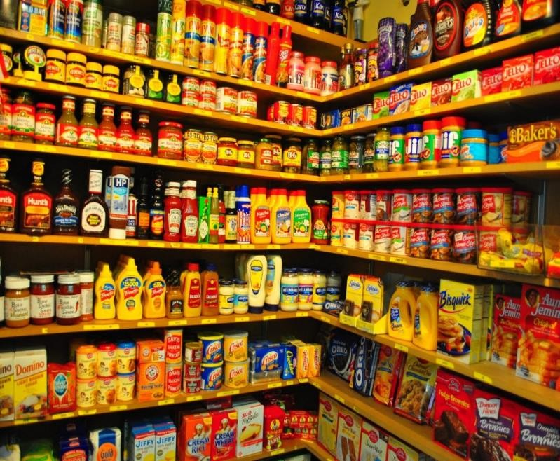
Grocery Shop Management System
8
2. LITERATURE SURVEY
A supermarket is a large form of the traditional grocery store, it is a self-service shop offering a wide variety of food and household products, organized into aisles. It is larger in size and has a wider selection than a traditional grocery store, but is smaller and more limited in the range of merchandise than a hypermarket or big-box market.
The concept of an inexpensive food market relying on large economies of scale was developed by Vincent Astor. He founded the Astor Market in 1915, investing $750,000 of his fortune into a 165 by 125 corner of in the famous
95 Manhattan avenue, creating in effect, an open air mini-mall that
sold meat, fruit, produce
and flowers. The expectation was that customers would come from great distances ("miles around"), but in the end even attracting people from ten blocks away was difficult, and the market folded in 1917. The concept of a super market was developed by entrepreneur Clarence
Saunders and his Piggly Wiggly stores. His first store opened in 1916. Saunders was awarded a number of patents for the ideas he incorporated into his stores. The stores were a financial success and Saunders began to offer franchises. The Great Atlantic & Pacific Tea Company, which was established in 1859, was another successful early grocery store chain in Canada and the United States, and became common in North American cities in the 1920s. The general trend in retail since then has been to stock shelves at night so that customers, the following day, can obtain their own goods and bring them to the front of the store to pay for them. Although there is a higher risk of shoplifting, the costs of appropriate security measures ideally will be outweighed by reduced labor cost.
Historically, there was debate about the origin of the supermarket, with King Kullen and Ralphs of California having strong claims. Other contenders included Weingarten's Big Food Markets and Henke & Pillot. To end the debate, the Food Marketing Institute in conjunction with the Smithsonian Institution and with funding from H.J. Heinz, researched the issue. It defined the

Slide 9
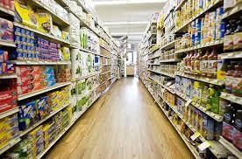
Grocery Shop Management System 9
attributes of a supermarket as "self-service, separate product departments, discount pricing, marketing and volume selling."
It has been determined that the first true supermarket in the United States was opened by a former Kroger employee, Michael J. Cullen, on August 4, 1930, inside a 6,000-square-foot (560 m²) former garage in Jamaica, Queens in New York City. The store, King Kullen, (inspired by the fictional character King Kong), operated under the
slogan "Pile it high. Sell it low." At the time of Cullen's death in 1936, there were seventeen King Kullen stores in operation. Although Saunders had brought the world self-service, uniform stores and nationwide marketing, Cullen built on this idea by adding separate food departments, selling
large volumes of food at discount prices and adding a parking lot.
Other established American grocery chains in the 1930s, such as Kroger and Safeway at first resisted Cullen's idea, but eventually were forced to build their own supermarkets as the economy sank into the Great Depression, while consumers were becoming price-sensitive at a level never experienced before. Kroger took the idea one step further and pioneered the first supermarket surrounded on all four sides by a parking lot.
Supermarkets proliferated across Canada and the United States with the growth of automobile ownership and suburban development after World War II. Most North American supermarkets are located in suburban strip shopping centers as an anchor store along with other smaller retailers. They are generally regional rather than national in their company branding. Kroger is perhaps the most nationally oriented supermarket chain in the United States but it has preserved most of its regional brands, including Ralphs, City Market, King Soopers, Fry's, Smith's, and QFC.
In Canada, the largest such chain is Loblaw, which operates stores under a variety of regional names, including Fortinos, Zehrs, No Frills, the Real Canadian Superstore, and the largest, Loblaws, (named after the company itself). Sobeys is Canada's second largest supermarket with locations across the country, operating under many banners (Sobeys IGA in Quebec). Québec's first supermarket opened in 1934 in Montréal, under the banner Steinberg's.
In the United Kingdom, self-service shopping took longer to become established. Even in 1947, there were just ten self-service shops in the country. In 1951, ex-US Navy sailor Patrick Galvani, son-in-law of Express Dairies chairman, made a pitch to the board to open a chain of supermarkets across the country. The UK's first supermarket under the new Premier Supermarkets brand opened

Slide 10
Grocery Shop Management System 10
in Streatham, South London, taking ten times as much per week as the average British general store of the time. Other chains caught on, and after Galvani lost out to Tesco's Jack Cohen in 1960 to buy the 212 Irwin's chain, the sector underwent a large amount of consolidation, resulting in 'the big four' dominant UK retailers of today: Tesco, Asda (owned by Wal- Mart), Sainsbury's and Morrisons.
In the 1950s, supermarkets frequently issued trading stamps as incentives to customers. Today, most chains issue store-specific "membership cards," "club cards," or "loyalty cards". These typically enable the card holder to receive special members-only discounts on certain items when the credit card-like device is scanned at check-out. Sales of selected data generated by club cards is becoming a significant revenue stream for some supermarkets.
3. SOFTWARE REQUIREMENTS SPECIFICATION
This are requirements specification for a software system, is a description of the behavior of a system to be developed and may include a set of use cases that describe interactions the users will have with the software. In addition it also contains non-functional requirements.
Non-functional requirements impose constraints on the design or implementation such as performance engineering requirements, quality standards
3.1 Hardware requirements
For a system to be used efficiently and accurately, all computer software needs certain hardware components or other software resources to be present on a computer. These prerequisites are known as (computer hardware specification) and are often used as a guideline as opposed to an absolute rule. Most software defines two sets of system requirements: minimum and recommended. With increasing demand for higher processing power and resources in newer versions of software, system requirements tend to increase over time. Industry analysts suggest that this trend plays a bigger part in driving upgrades to existing computer systems than technological advancements. A second meaning of the term of System requirements is a generalization of this first definition, giving the requirements to be met in the design of a system or sub-system. Typically an organization starts with a set of Business requirements and then derives the System requirements from there. The most common set of requirements defined by any operating system or software application is the physical computer resources, also known as hardware, A hardware requirements list is often accompanied by a hardware compatibility list (HCL), especially in case of operating systems. An HCL lists tested, compatible, and sometimes incompatible hardware devices for a

Slide 11
Grocery Shop Management System 11
particular operating system or application. The following sub-sections discuss the various aspects of hardware requirements for this application software
The hardware required includes the following:
Name of component Specification
Processsor Pentium lll 630MHz
RAM 128 MB
Hard disk 20 GB
Monitor 15” color monitor
Keyboard 122 keys
3.2 Software requirements
Software requirements specification establishes the basis for agreement between customers and contractors or suppliers (in market-driven projects, these roles may be played by the marketing and development divisions) on what the software product is to do as well as what it is not expected to do. Software requirements specification permits a rigorous assessment of requirements before design can begin and reduces later redesign. It should also provide a realistic basis for estimating product costs, risks, and schedules.
The software requirements specification document enlists enough and necessary requirements that are required for the project development. To derive the requirements we need to have clear and thorough understanding of the products to be developed or being developed. This is achieved and refined with detailed and continuous communications with the project team and customer till the completion of the software.
The software components used for this project are listed below:
Web server: Language Used: Database Used: Design Interface: Browser: Software:
Apache PHP
My SQL
Bootstrap JavaScript, HTML, Ajax, JQuery Opera Mozilla Google Chrome IE8 WAMP/ XAMPP/ LAMP/MAMP

Slide 12
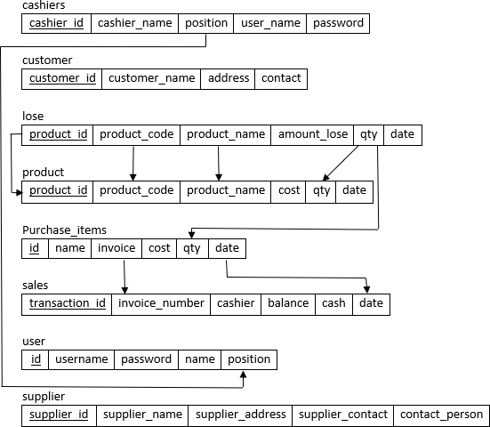
Grocery Shop Management System
12
4. DESIGN
4.1 Schema Diagram
A database schema is the skeleton structure that represents the logical view of the entire database. It defines how the data is organized and how the relations among them are associated. It formulates all the constraints that are to be applied on the data.
A database schema defines its entities and the relationship among them. It contains a descriptive detail of the database, which can be depicted by means of schema diagrams. It’s the database designers who design the schema to help programmers understand the database and make it useful.
4.2 Entity Relationship Diagram

Slide 13
Grocery Shop Management System 13
An Entity–relationship model (ER model) describes the structure of a database with the help of a diagram, which is known as Entity Relationship Diagram (ER Diagram). An ER model is a design or blueprint of a database that can later be implemented as a database. The main components of E-R model are: entity set and relationship set.
An ER diagram shows the relationship among entity sets. An entity set is a group of similar entities and these entities can have attributes. In terms of DBMS, an entity is a table or attribute of a table in database, so by showing relationship among tables and their attributes, ER diagram shows the complete logical structure of a database. Lets have a look at a simple ER diagram to understand this concept.
In the ER diagram, we have the following entities and attributes:
Cashier Entity : Attributes of Cashier are cashier_id, cashier_name, position,user_name,password
Customer Entity : Attributes of Customer are customer_id, customer_name, address, contact
Products Entity : Attributes of Products are product_id, product_code, product_name, cost, qty, date
Sales Entity : Attributes of Sales are transaction_id, invoice_number, cashier, balance, cash, date
Lose Entity : Attributes of Lose are product_id, product_name, product_code, cost, qty, date
Purchase_items Entity : Attributes of Purchase_items are id, name, invoice, cost, qty, date
User Entity : Attributes of User are id, username, password, name, position
Supplier Entity : Attributes of supplier are supplier_id, supplier_name, supplier_address, supplier_contact, contact_persons

Slide 14
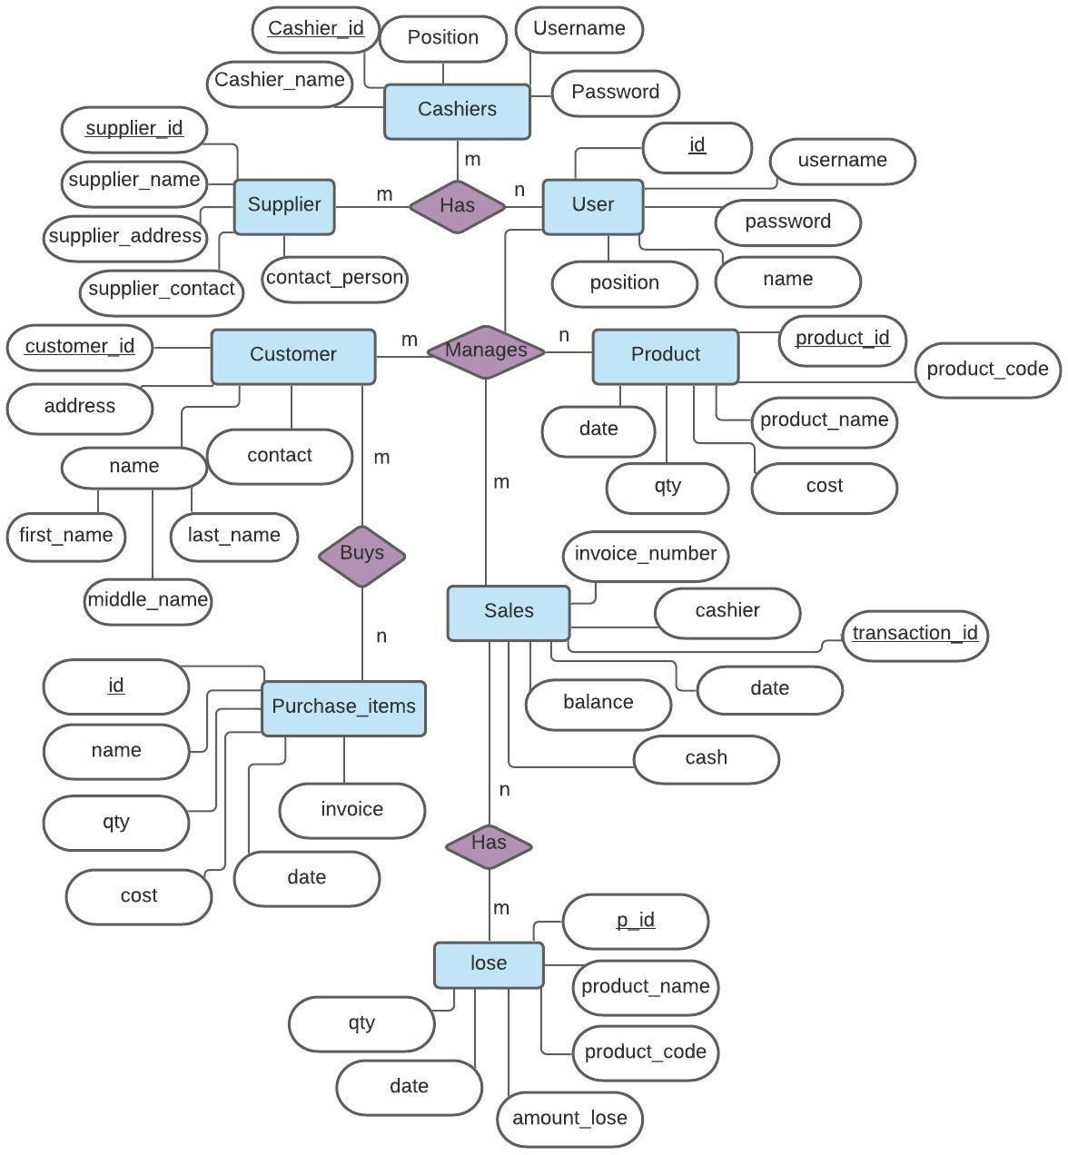
Grocery Shop Management System
14
ER Diagram of Grocery Shop Management System
5. IMPLEMENTATION

Slide 15
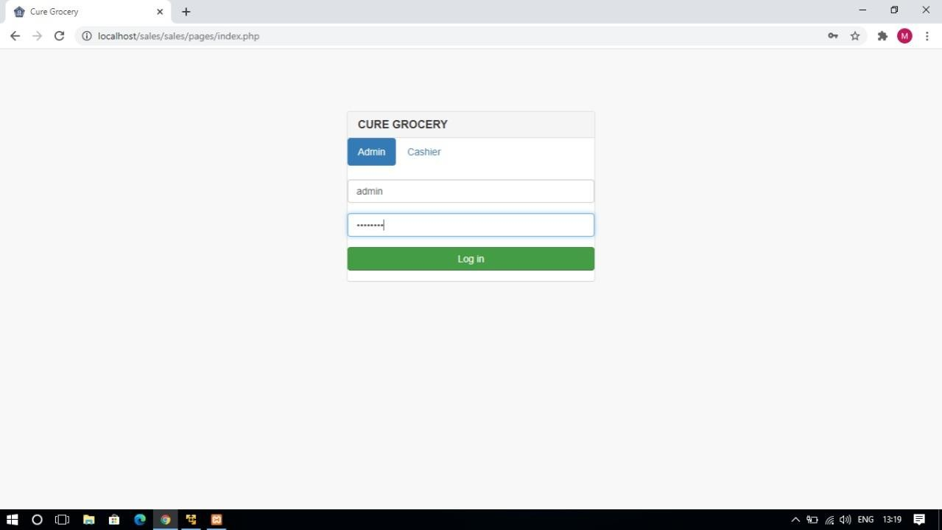
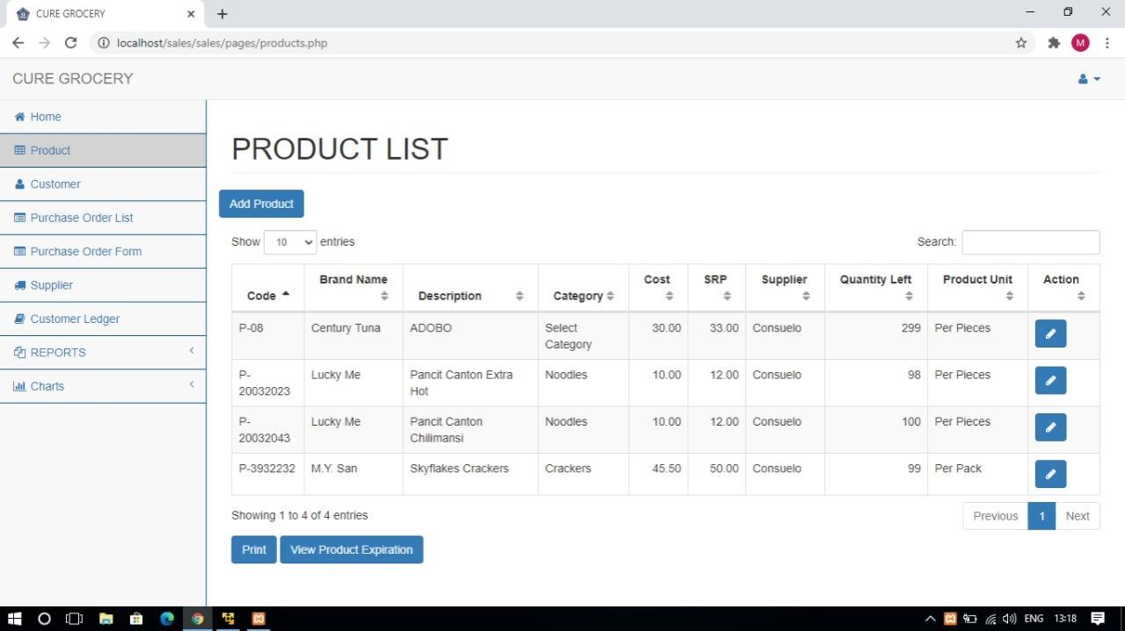
Grocery Shop Management System
15
5.1 Implementaion with Screenshot
Home Page

Slide 16
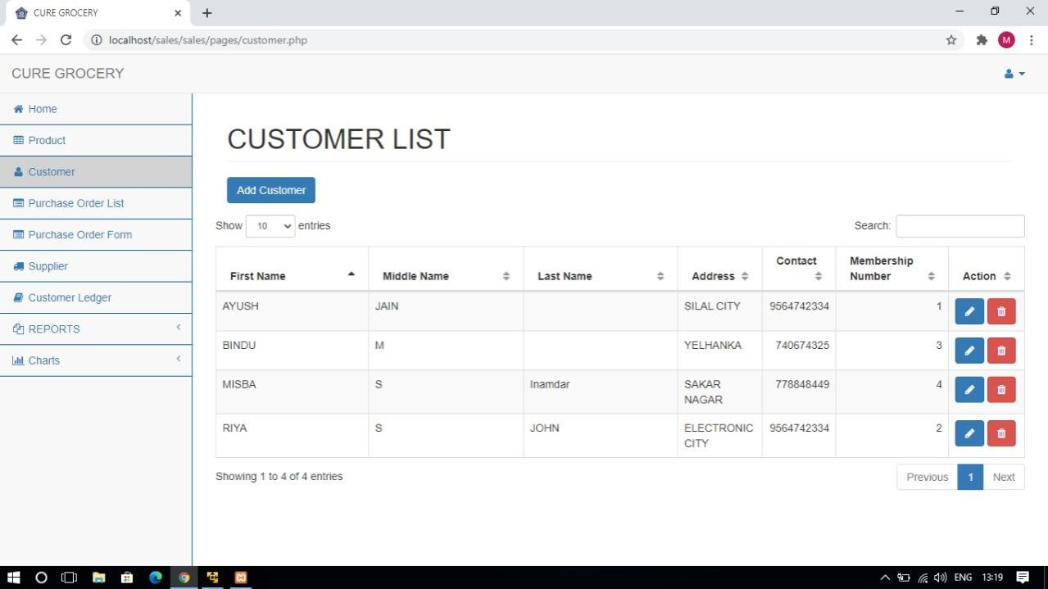
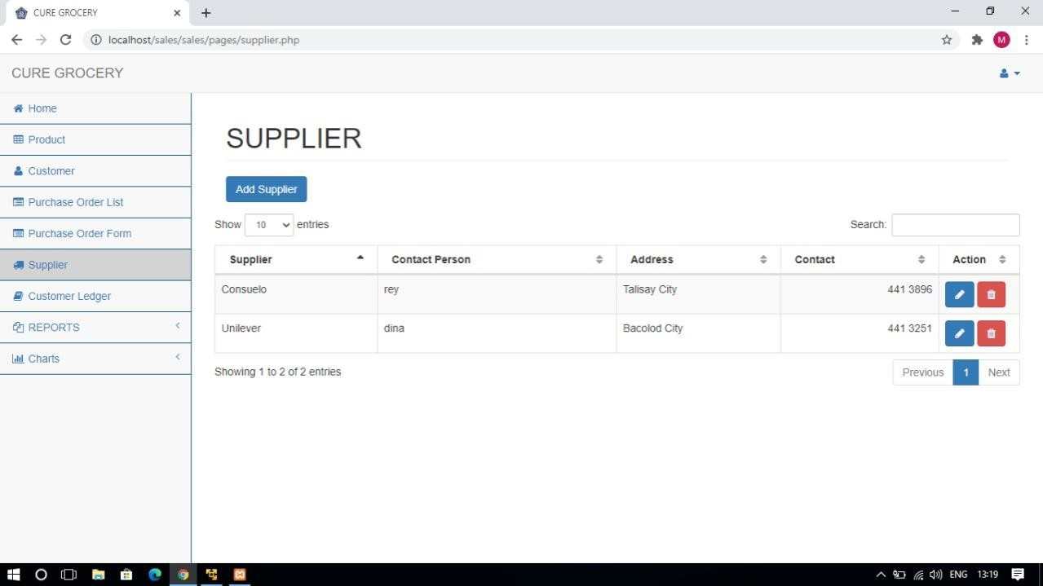
Grocery Shop Management System
16

Slide 17
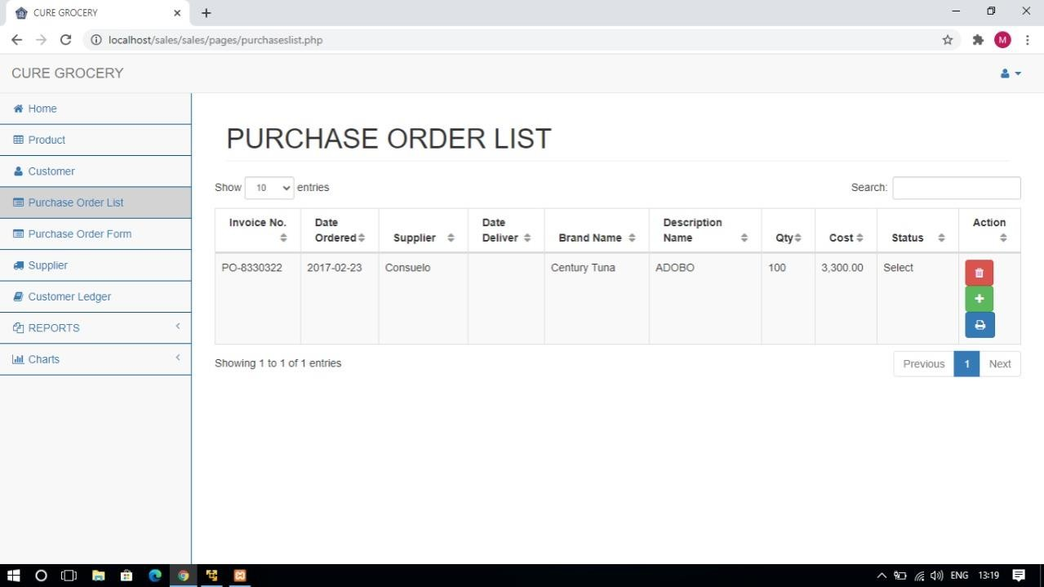
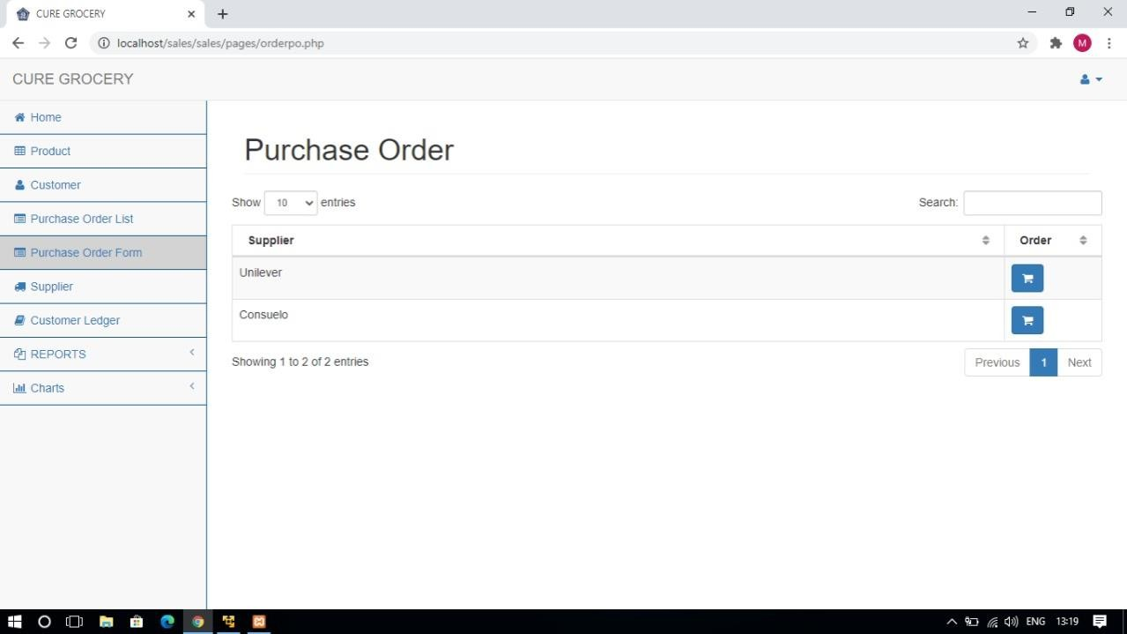
Grocery Shop Management System
17

Slide 18
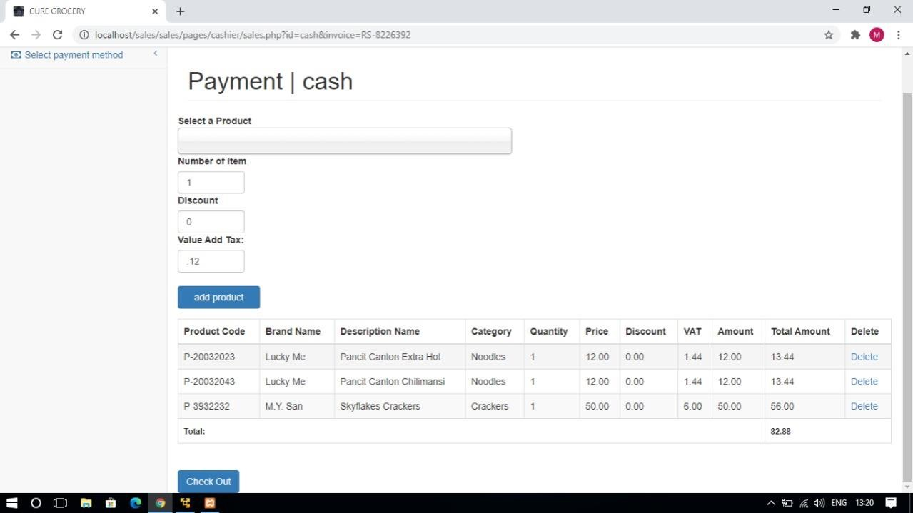
Grocery Shop Management System
18

Slide 19
Grocery Shop Management System
19
5.2Code
-- phpMyAdmin SQL Dump
-- version 4.5.1
-- http://www.phpmyadmin.net
--
-- Host: 127.0.0.1
-- Generation Time: Mar 08, 2017 at 04:30 AM
-- Server version: 10.1.13-MariaDB
-- PHP Version: 5.5.37
SET SQL_MODE = "NO_AUTO_VALUE_ON_ZERO";
SET time_zone = "+00:00";
/*!40101 SET @OLD_CHARACTER_SET_CLIENT=@@CHARACTER_SET_CLIENT */;
/*!40101 SET @OLD_CHARACTER_SET_RESULTS=@@CHARACTER_SET_RESULTS
*/;
/*!40101 SET @OLD_COLLATION_CONNECTION=@@COLLATION_CONNECTION */;
/*!40101 SET NAMES utf8mb4 */;
--
-- Database: `inventory`
--
--
-- Table structure for table `cashier`
--
CREATE TABLE `cashier` (
`cashier_id` int(10) NOT NULL,
`cashier_name` varchar(100) NOT NULL,
`position` varchar(100) NOT NULL,
`username` varchar(100) NOT NULL,
`password` varchar(100) NOT NULL
) ENGINE=InnoDB DEFAULT CHARSET=latin1;
--
-- Dumping data for table `cashier`
--
INSERT INTO `cashier` (`cashier_id`, `cashier_name`, `position`, `username`, `password`) VALUES
(1, 'Cashier', 'cashier', 'cashier', '12345');
--
-- Table structure for table `collection`

Slide 20
Grocery Shop Management System
20
--
CREATE TABLE `collection` (
`transaction_id` int(11) NOT NULL,
`date` varchar(100) NOT NULL,
`name` varchar(100) NOT NULL,
`invoice` varchar(100) NOT NULL,
`amount` varchar(100) NOT NULL,
`remarks` varchar(100) NOT NULL,
`balance` int(11) NOT NULL
) ENGINE=InnoDB DEFAULT CHARSET=latin1;
--
-- Table structure for table `customer`
--
CREATE TABLE `customer` (
`customer_id` int(11) NOT NULL,
`customer_name` varchar(100) NOT NULL,
`address` varchar(100) NOT NULL,
`contact` varchar(100) NOT NULL,
`membership_number` varchar(100) NOT NULL,
`first_name` varchar(50) NOT NULL,
`middle_name` varchar(50) NOT NULL,
`last_name` varchar(50) NOT NULL
) ENGINE=InnoDB DEFAULT CHARSET=latin1;
--
-- Dumping data for table `customer`
--
INSERT INTO `customer` (`customer_id`, `customer_name`, `address`, `contact`,
`membership_number`, `first_name`, `middle_name`, `last_name`) VALUES (1, 'Customer', 'Silay City', '4536974', '1', 'customer', 'customer', 'customer');
--
-- Table structure for table `lose`
--
CREATE TABLE `lose` (
`p_id` int(10) NOT NULL,
`product_code` varchar(30) NOT NULL,
`product_name` varchar(30) NOT NULL,
`description_name` varchar(30) NOT NULL,
`amount_lose` varchar(30) NOT NULL,
`qty` varchar(30) NOT NULL,
`cost` varchar(30) NOT NULL,

Slide 21
Grocery Shop Management System
21
`date` varchar(30) NOT NULL,
`category` varchar(20) NOT NULL,
`exdate` varchar(30) NOT NULL
) ENGINE=InnoDB DEFAULT CHARSET=latin1;
--
-- Dumping data for table `lose`
--
INSERT INTO `lose` (`p_id`, `product_code`, `product_name`, `description_name`,
`amount_lose`, `qty`, `cost`, `date`, `category`, `exdate`) VALUES
(1, 'P-08', 'Century Tuna', 'ADOBO', '3000', '100', '30', '02-23-2017', 'Canned Goods', '2017-05-
27');
--
-- Table structure for table `products`
--
CREATE TABLE `products` (
`product_id` int(11) NOT NULL,
`product_code` varchar(50) NOT NULL,
`product_name` varchar(100) NOT NULL,
`description_name` varchar(50) NOT NULL,
`unit` varchar(15) NOT NULL,
`cost` varchar(100) NOT NULL,
`price` varchar(100) NOT NULL,
`supplier` varchar(100) NOT NULL,
`qty_left` int(10) NOT NULL,
`category` varchar(100) NOT NULL,
`date_delivered` varchar(20) NOT NULL,
`expiration_date` varchar(20) NOT NULL
) ENGINE=InnoDB DEFAULT CHARSET=latin1;
--
-- Dumping data for table `products`
--
INSERT INTO `products` (`product_id`, `product_code`, `product_name`, `description_name`,
`unit`, `cost`, `price`, `supplier`, `qty_left`, `category`, `date_delivered`, `expiration_date`) VALUES
(1, 'P-08', 'Century Tuna', 'ADOBO', 'Per Pieces', '30', '33', 'Consuelo', 100, 'Canned Goods',
'2017-02-20', ''),
(2, 'P-20032023', 'Lucky Me', 'Pancit Canton Extra Hot', 'Per Pieces', '10', '12', 'Consuelo', 100, 'Noodles', '2017-01-21', '2017-07-13'),
(3, 'P-20032043', 'Lucky Me', 'Pancit Canton Chilimansi', 'Per Pieces', '10', '12', 'Consuelo', 100,
'Noodles', '2017-02-21', '2017-06-30'),
(4, 'P-3932232', 'M.Y. San', 'Skyflakes Crackers', 'Per Pack', '45.50', '50', 'Consuelo', 100,
'Crackers', '2017-02-21', '2017-07-27');

Slide 22
Grocery Shop Management System
22
--
-- Table structure for table `purchases`
--
CREATE TABLE `purchases` (
`transaction_id` int(11) NOT NULL,
`invoice_number` varchar(100) NOT NULL,
`date_order` varchar(100) NOT NULL,
`suplier` varchar(100) NOT NULL,
`date_deliver` varchar(100) NOT NULL,
`p_name` varchar(30) NOT NULL,
`qty` varchar(30) NOT NULL,
`cost` varchar(30) NOT NULL,
`status` varchar(25) NOT NULL,
`remark` varchar(100) NOT NULL
) ENGINE=InnoDB DEFAULT CHARSET=latin1;
--
-- Dumping data for table `purchases`
--
INSERT INTO `purchases` (`transaction_id`, `invoice_number`, `date_order`, `suplier`,
`date_deliver`, `p_name`, `qty`, `cost`, `status`, `remark`) VALUES
(1, 'PO-8330322', '2017-02-23', 'Consuelo', '', 'P-08', '100', '3300', 'Returned', 'Expired
Products\r\n');
--
-- Table structure for table `purchases_item`
--
CREATE TABLE `purchases_item` (
`id` int(11) NOT NULL,
`name` varchar(100) NOT NULL,
`qty` int(11) NOT NULL,
`cost` varchar(100) NOT NULL,
`invoice` varchar(100) NOT NULL,
`status` varchar(25) NOT NULL,
`date` varchar(25) NOT NULL
) ENGINE=InnoDB DEFAULT CHARSET=latin1;
--
-- Dumping data for table `purchases_item`
--
INSERT INTO `purchases_item` (`id`, `name`, `qty`, `cost`, `invoice`, `status`, `date`) VALUES
(1, 'P-08', 100, '3300', 'PO-8330322', 'Returned', '2017-02-23');

Slide 23
Grocery Shop Management System
23
--
-- Table structure for table `sales`
--
CREATE TABLE `sales` (
`transaction_id` int(11) NOT NULL,
`invoice_number` varchar(100) NOT NULL,
`cashier` varchar(100) NOT NULL,
`date` varchar(100) NOT NULL,
`type` varchar(100) NOT NULL,
`amount` varchar(100) NOT NULL,
`due_date` varchar(100) NOT NULL,
`name` varchar(100) NOT NULL,
`balance` varchar(100) NOT NULL,
`total_amount` varchar(30) NOT NULL,
`cash` varchar(100) NOT NULL,
`month` varchar(20) NOT NULL,
`year` varchar(20) NOT NULL,
`p_amount` varchar(30) NOT NULL,
`vat` varchar(30) NOT NULL
) ENGINE=InnoDB DEFAULT CHARSET=latin1;
--
-- Dumping data for table `sales`
--
INSERT INTO `sales` (`transaction_id`, `invoice_number`, `cashier`, `date`, `type`, `amount`,
`due_date`, `name`, `balance`, `total_amount`, `cash`, `month`, `year`, `p_amount`, `vat`) VALUES
(1, 'RS-33200322', 'Rizaldy Loren', '02/21/2017', 'cash', '184.8', '', 'Renzy Jerota Loren', '', '',
'185', 'February', '2017', '165', '19.8');
--
-- Table structure for table `sales_order`
--
CREATE TABLE `sales_order` (
`transaction_id` int(11) NOT NULL,
`invoice` varchar(100) NOT NULL,
`product` varchar(100) NOT NULL,
`qty` varchar(100) NOT NULL,
`amount` varchar(100) NOT NULL,
`name` varchar(100) NOT NULL,
`price` varchar(100) NOT NULL,
`discount` varchar(100) NOT NULL,
`category` varchar(100) NOT NULL,

Slide 24
Grocery Shop Management System
24
`date` varchar(25) NOT NULL,
`omonth` varchar(25) NOT NULL,
`oyear` varchar(25) NOT NULL,
`qtyleft` varchar(25) NOT NULL,
`dname` varchar(50) NOT NULL,
`vat` varchar(20) NOT NULL,
`total_amount` varchar(30) NOT NULL
) ENGINE=InnoDB DEFAULT CHARSET=latin1;
--
-- Dumping data for table `sales_order`
--
INSERT INTO `sales_order` (`transaction_id`, `invoice`, `product`, `qty`, `amount`, `name`,
`price`, `discount`, `category`, `date`, `omonth`, `oyear`, `qtyleft`, `dname`, `vat`,
`total_amount`) VALUES
(1, 'RS-33200322', 'P-08', '5', '165', 'Century Tuna', '33', '0', 'Canned Goods', '02/21/2017',
'February', '2017', '95', 'ADOBO', '19.8', '184.8');
--
-- Table structure for table `supliers`
--
CREATE TABLE `supliers` (
`suplier_id` int(11) NOT NULL,
`suplier_name` varchar(100) NOT NULL,
`suplier_address` varchar(100) NOT NULL,
`suplier_contact` varchar(100) NOT NULL,
`contact_person` varchar(100) NOT NULL
) ENGINE=InnoDB DEFAULT CHARSET=latin1;
--
-- Dumping data for table `supliers`
--
INSERT INTO `supliers` (`suplier_id`, `suplier_name`, `suplier_address`, `suplier_contact`,
`contact_person`) VALUES
(1, 'Unilever', 'Bacolod City', '441 3251', 'dina'),
(2, 'Consuelo', 'Talisay City', '441 3896', 'rey');
--
-- Table structure for table `user`
--
CREATE TABLE `user` (
`id` int(11) NOT NULL,
`username` varchar(100) NOT NULL,

Slide 25
Grocery Shop Management System
25
`password` varchar(100) NOT NULL,
`name` varchar(100) NOT NULL,
`position` varchar(100) NOT NULL
) ENGINE=InnoDB DEFAULT CHARSET=latin1;
--
-- Dumping data for table `user`
--
INSERT INTO `user` (`id`, `username`, `password`, `name`, `position`) VALUES (1, 'admin', 'admin123', 'Admin', 'Admin');
--
-- Indexes for dumped tables
--
--
-- Indexes for table `cashier`
--
ALTER TABLE `cashier`
ADD PRIMARY KEY (`cashier_id`);
--
-- Indexes for table `collection`
--
ALTER TABLE `collection`
ADD PRIMARY KEY (`transaction_id`);
--
-- Indexes for table `customer`
--
ALTER TABLE `customer`
ADD PRIMARY KEY (`customer_id`);
--
-- Indexes for table `lose`
--
ALTER TABLE `lose`
ADD PRIMARY KEY (`p_id`);
--
-- Indexes for table `products`
--
ALTER TABLE `products`
ADD PRIMARY KEY (`product_id`);
--
-- Indexes for table `purchases`
--
ALTER TABLE `purchases`
ADD PRIMARY KEY (`transaction_id`);

Slide 26
Grocery Shop Management System
26
--
-- Indexes for table `purchases_item`
--
ALTER TABLE `purchases_item` ADD PRIMARY KEY (`id`);
--
-- Indexes for table `sales`
--
ALTER TABLE `sales`
ADD PRIMARY KEY (`transaction_id`);
--
-- Indexes for table `sales_order`
--
ALTER TABLE `sales_order`
ADD PRIMARY KEY (`transaction_id`);
--
-- Indexes for table `supliers`
--
ALTER TABLE `supliers`
ADD PRIMARY KEY (`suplier_id`);
--
-- Indexes for table `user`
--
ALTER TABLE `user`
ADD PRIMARY KEY (`id`);
--
-- AUTO_INCREMENT for dumped tables
--
--
-- AUTO_INCREMENT for table `cashier`
--
ALTER TABLE `cashier`
MODIFY `cashier_id` int(10) NOT NULL AUTO_INCREMENT, AUTO_INCREMENT=2;
--
-- AUTO_INCREMENT for table `collection`
--
ALTER TABLE `collection`
MODIFY `transaction_id` int(11) NOT NULL AUTO_INCREMENT;
--
-- AUTO_INCREMENT for table `customer`
--
ALTER TABLE `customer`
MODIFY `customer_id` int(11) NOT NULL AUTO_INCREMENT, AUTO_INCREMENT=2;

Slide 27
Grocery Shop Management System 27
--
-- AUTO_INCREMENT for table `lose`
--
ALTER TABLE `lose`
MODIFY `p_id` int(10) NOT NULL AUTO_INCREMENT, AUTO_INCREMENT=2;
--
-- AUTO_INCREMENT for table `products`
--
ALTER TABLE `products`
MODIFY `product_id` int(11) NOT NULL AUTO_INCREMENT, AUTO_INCREMENT=5;
--
-- AUTO_INCREMENT for table `purchases`
--
ALTER TABLE `purchases`
MODIFY `transaction_id` int(11) NOT NULL AUTO_INCREMENT, AUTO_INCREMENT=2;
--
-- AUTO_INCREMENT for table `purchases_item`
--
ALTER TABLE `purchases_item`
MODIFY `id` int(11) NOT NULL AUTO_INCREMENT, AUTO_INCREMENT=2;
--
-- AUTO_INCREMENT for table `sales`
--
ALTER TABLE `sales`
MODIFY `transaction_id` int(11) NOT NULL AUTO_INCREMENT, AUTO_INCREMENT=2;
--
-- AUTO_INCREMENT for table `sales_order`
--
ALTER TABLE `sales_order`
MODIFY `transaction_id` int(11) NOT NULL AUTO_INCREMENT, AUTO_INCREMENT=3;
--
-- AUTO_INCREMENT for table `supliers`
--
ALTER TABLE `supliers`
MODIFY `suplier_id` int(11) NOT NULL AUTO_INCREMENT, AUTO_INCREMENT=3;
--
-- AUTO_INCREMENT for table `user`
--
ALTER TABLE `user`
MODIFY `id` int(11) NOT NULL AUTO_INCREMENT, AUTO_INCREMENT=2;
/*!40101 SET CHARACTER_SET_CLIENT=@OLD_CHARACTER_SET_CLIENT */;
/*!40101 SET CHARACTER_SET_RESULTS=@OLD_CHARACTER_SET_RESULTS */;
/*!40101 SET COLLATION_CONNECTION=@OLD_COLLATION_CONNECTION */;
<!DOCTYPE html>

Slide 28
Grocery Shop Management System
28
<html lang="en">
<head>
<meta charset="utf-8">
<meta http-equiv="X-UA-Compatible" content="IE=edge">
<meta name="viewport" content="width=device-width, initial-scale=1">
<meta name="description" content="">
<meta name="author" content="">
<title>Cure Grocery</title>
<link rel="shortcut icon" href="logoc.jpg">
<!-- Bootstrap Core CSS -->
<link href="../vendor/bootstrap/css/bootstrap.min.css" rel="stylesheet">
<!-- MetisMenu CSS -->
<link href="../vendor/metisMenu/metisMenu.min.css" rel="stylesheet">
<!-- Custom CSS -->
<link href="../dist/css/sb-admin-2.css" rel="stylesheet">
<!-- Custom Fonts -->
<link href="../vendor/font-awesome/css/font-awesome.min.css" rel="stylesheet" type="text/css">
<body>
<!-- HTML5 Shim and Respond.js IE8 support of HTML5 elements and media
queries -->
<!-- WARNING: Respond.js doesn't work if you view the page via file:// -->
<!--[if lt IE 9]>
<script src="https://oss.maxcdn.com/libs/html5shiv/3.7.0/html5shiv.js"></script>
<script src="https://oss.maxcdn.com/libs/respond.js/1.4.2/respond.min.js"></script>
<![endif]-->
</head>
<body>
<?php
function createRandomPassword() {
$chars = "003232303232023232023456789";
srand((double)microtime()*1000000);
$i = 0;
$pass = '' ;
while ($i <= 7) {

Slide 29
Grocery Shop Management System
29
$num = rand() % 33;
$tmp = substr($chars, $num, 1);
$pass = $pass . $tmp;
$i++;
}
return $pass;
}
$finalcode='RS-'.createRandomPassword();
?>
<div class="container">
<div class="row">
<div class="col-md-4 col-md-offset-4">
<div class="login-panel panel panel-default">
<div class="panel-heading">
<h3 class="panel-title"><b>CURE GROCERY
</b></h3>
</div>
<ul class="nav nav-pills">
<li class="active"><a data-toggle="pill"
href="#home">Admin</a></li>
<li><a data-toggle="pill"
href="#menu2">Cashier</a></li>
</ul>
<div class="tab-content">
<!-- Department -->
<div id="home" class="tab-pane fade in active">
<br />
<form method="post" name="admin_form">
<div class="form-group">
<input type="text" class="form-
control" name="username" placeholder="Username">
</div>
<div class="form-group">
<input type="password"
class="form-control" name="pass" placeholder="Password">
</div>
<div class="form-group">
<button class="btn btn-block
btn-success" id = "btn-login" name = "btn-login">Log in</button>
</div>
<div class="form-group" id="alert-
msg">
</div>
</form>
</div>

Slide 30
Grocery Shop Management System 30
<div id="menu2" class="tab-pane fade">
<br />
<form method="post" name="cashier_form">
<div class="form-group">
<input type="text" class="form-
control" name="cashier_username" placeholder="Username">
</div>
<div class="form-group">
<input type="password" class="form-control" name="cashier_pass" placeholder="Password">
</div>
<div class="form-group">
<button class="btn btn-block
btn-success" id = "btn" name = "btn">Log in</button>
</div>
<div class="form-group" id="alert-
msg1">
</div>
</form>
</div>
</div>
</div>
</div>
</div>
</div>
<!-- jQuery -->
<script src="../vendor/jquery/jquery.min.js"></script>
<!-- Bootstrap Core JavaScript -->
<script src="../vendor/bootstrap/js/bootstrap.min.js"></script>
<!-- Metis Menu Plugin JavaScript -->
<script src="../vendor/metisMenu/metisMenu.min.js"></script>
<!-- Custom Theme JavaScript -->
<script src="../dist/js/sb-admin-2.js"></script>
<script type="text/javascript"> jQuery(function(){
$('form[name="admin_form"]').on('submit', function(donard){
donard.preventDefault();
var a = $(this).find('input[name="username"]').val(); var b = $(this).find('input[name="pass"]').val();
if (a === '' && b ===''){
$('#alert-msg').html('<div class="alert alert-danger">All fields
are required!</div>');
}else{
$.ajax({

Slide 31
Grocery Shop Management System
31
type: 'POST',
url: 'new_login.php', data: {
username: a,
password: b
},
beforeSend: function(){
$('#alert-msg').html('');
}
})
.done(function(donard){
if (donard == 0){
$('#alert-msg').html('<div class="alert alert-
danger">Incorrect username or password!</div>');
}else{
$("#btn-login").html('<img src="loading.gif"
/> &nbsp; Signing In ...');
setTimeout(' window.location.href =
"home.php"; ',2000);
}
});
}
});
$('form[name="cashier_form"]').on('submit', function(donard){ donard.preventDefault();
var a = $(this).find('input[name="cashier_username"]').val(); var b = $(this).find('input[name="cashier_pass"]').val();
if (a === '' && b ===''){
$('#alert-msg1').html('<div class="alert alert-danger">All
fields are required!</div>');
}else{
$.ajax({
type: 'POST',
url: 'cashier/new_login.php', data: {
username: a, password: b
},
beforeSend: function(){
$('#alert-msg1').html('');
}
})
.done(function(donard){
if (donard == 0){
$('#alert-msg1').html('<div class="alert alert-
danger">Incorrect username or password!</div>');
}else{

Slide 32
Grocery Shop Management System
32
&nbsp; Signing In ...');
$("#btn").html('<img src="loading.gif" />
setTimeout(' window.location.href = "cashier/sales.php?id=cash&invoice=<?php echo $finalcode ?>"; ',2000);
}
});
}
});
});
</script>
</body>44
</html>
6. CONCLUSION AND FUTURE ENHANCEMENTS
Conclusion
Grocery Shop Management System has to do with making appropriate effort to stop the rising problem to all manual supermarket operation in order to enhance the operation of such supermarket. In this project, the software or system that can be used to aid all supermarkets that is still operating manually have been successfully developed. The software can be implementing in all types of supermarket as mentioned in the second chapter. The software has a large memory of storing all the goods in the supermarket and also keeping record it is highly effective and accurate.
Future Enhancement
In the future, the following components can be added to the system in order to improve the effectiveness and efficiency of the system, which includes:
An advanced password system that will be embedded into all login pages to increase the security of the system.
A good Printing module should be included.
A good internet backup should be automated after everyday sales.
Internet Transactions should be allowed.

Slide 33
Grocery Shop Management System
33
7. REFERENCES
ww.google.com
Database Programming with JDBC and Java by O’Reilly
http://www.jdbc-tutorial.com/
https://www.tutorialspoint.com/java/
https://docs.oracle.com/javase/tutorial/
http://www.tutorialspoint.com/mysql/
httpd.apache.org/docs/2.0/misc/tutorials.html/

